Slide 1
A Network Sniffing Tool :
Text Bandit
Supervised By : Mohammed Shafiul Alam Khan
Submited By : Pritom Kumar Das
Roll : 0919
Date: 07 March , 2018

Slide 2
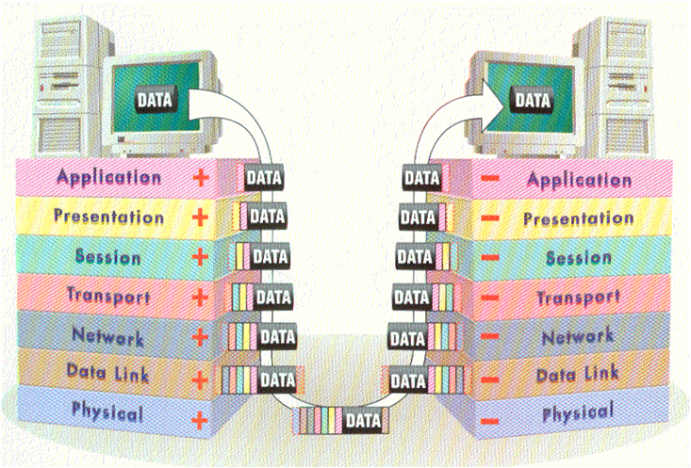
Background
figure 1 : Data Transport in network.
Slide No 1
Date: 07 March , 2018

Slide 3
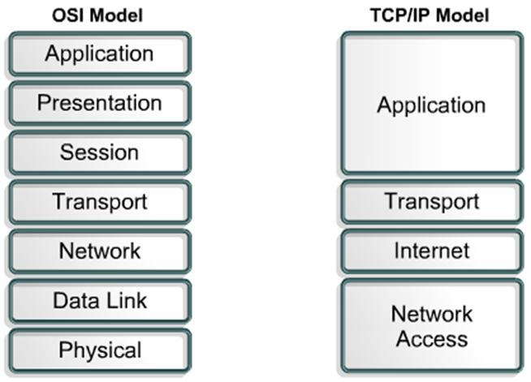
Background
figure 2 : OSI to TCP Model
Date: 07 March , 2018
Slide No 2

Slide 4
Motivation
Motivation
This project will help me learn a lot about networking and data transfer in layers and reading raw data from packets.
Slide No 3
Date: 07 March , 2018

Slide 5
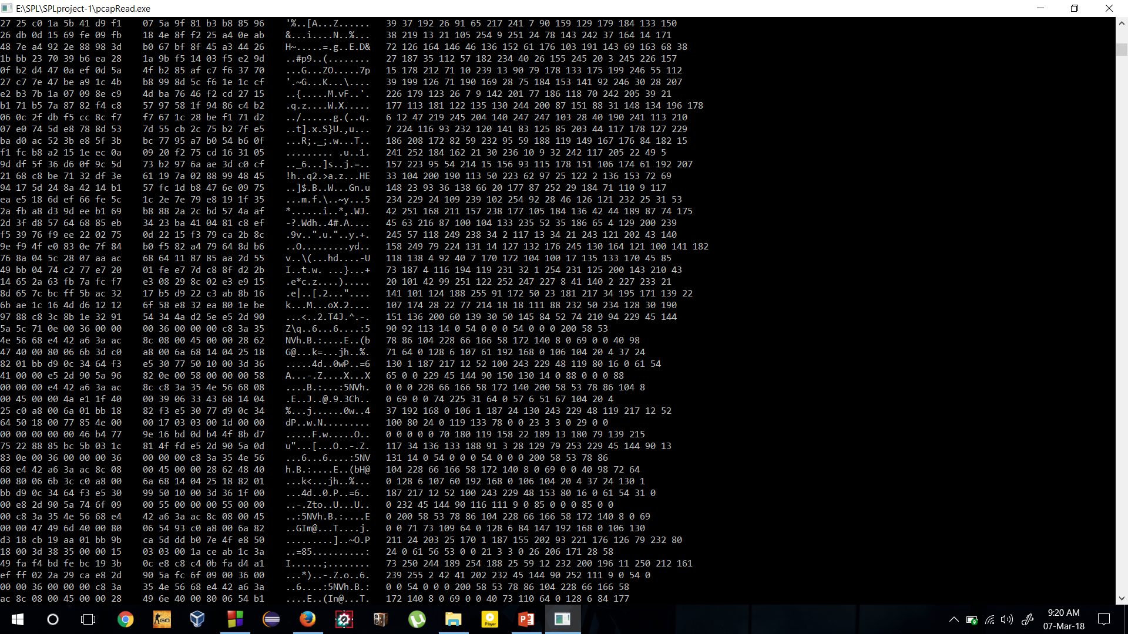
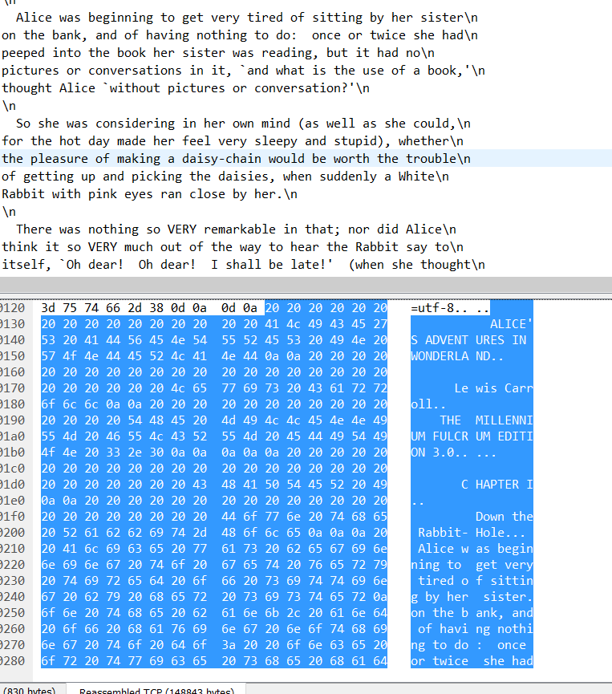
My Work
Figure 3 : Packets to Text file .
Slide No 4
Date: 07 March , 2018

Slide 6
My Work
My work so far ---
Read PCAP file.
Convert binary data to character and integer .
Identify the data payload from individual packets .
Date: 07 March , 2018
Slide No 5

Slide 7
Future Work
Completely extract a text file from PCAP file .
Use sockets to capture packets.
Date: 07 March , 2018
Slide No 6

Slide 8
Advantage of Text Sniffing
Know if the packets transmitted are secured or not .
Use it for http data capturing .
Slide No 7
Date: 07 March , 2018

Slide 9
Project Boundary
This project can only extract readable data without http/tcp
Packets .
Slide No 8
Date: 07 March , 2018

Slide 10
Github Link Here
https://github.com/PritomKumar/SPLproject-1
Date: 07 March , 2018
Slide No 9

Slide 11
Thank You
Slide No 10
Date: 07 March , 2018

